Slide 1
Disclaimers
We hope you find the information on our website and resources useful.
Animations
This resource has been designed with animations to make it as fun and engaging as possible. To view the content in the correct formatting, please view the PowerPoint in ‘slide show mode’. This takes you from desktop to presentation mode. If you view the slides out of ‘slide show mode’, you may find that some of the text and images overlap each other and/or are difficult to read.
To enter slide show mode, go to the slide show menu tab and select either from beginning or from current slide.
Links to External Websites
This resource contains links to external websites. Please be aware that the inclusion of any link in this resource should not be taken as an endorsement of any kind by Twinkl of the linked website or any association with its operators. You should also be aware that we have no control over the availability of the linked pages. If the link is not working, please let us know by contacting TwinklCares and we will try to fix it although we can assume no responsibility if this is the case. We are not responsible for the content of external sites.
The following presentation was made in line with the BBC micro:bit v2.
Information in this presentation may not be applicable to other versions of the micro:bit.
You may wish to delete this slide before beginning the presentation.

Slide 3
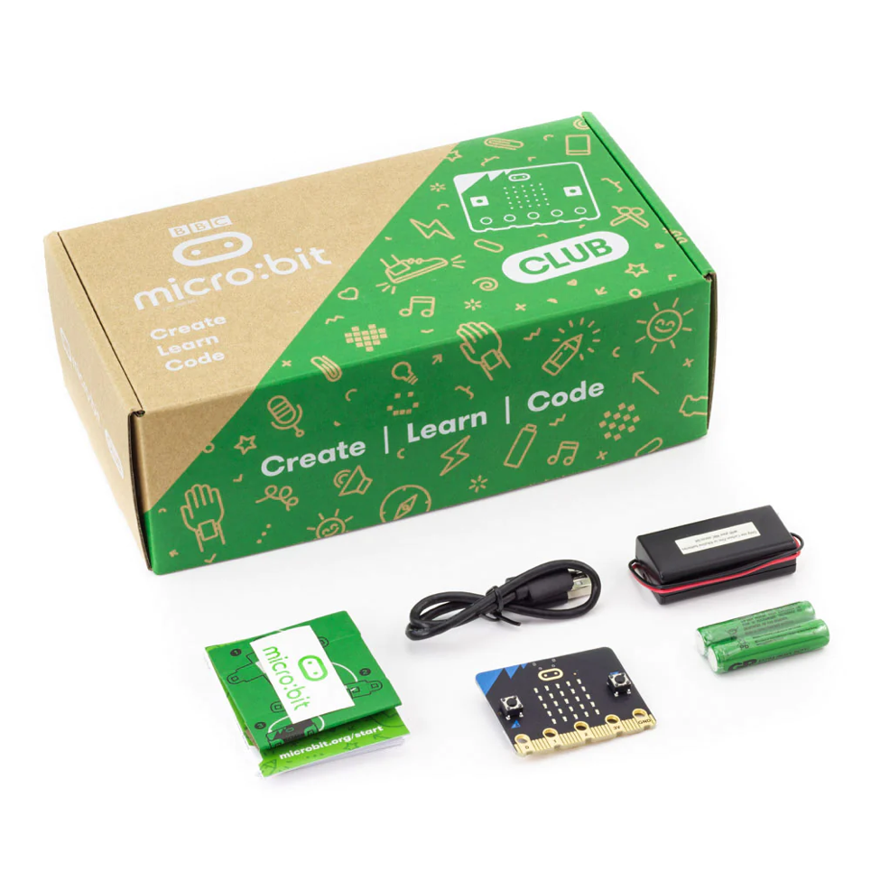
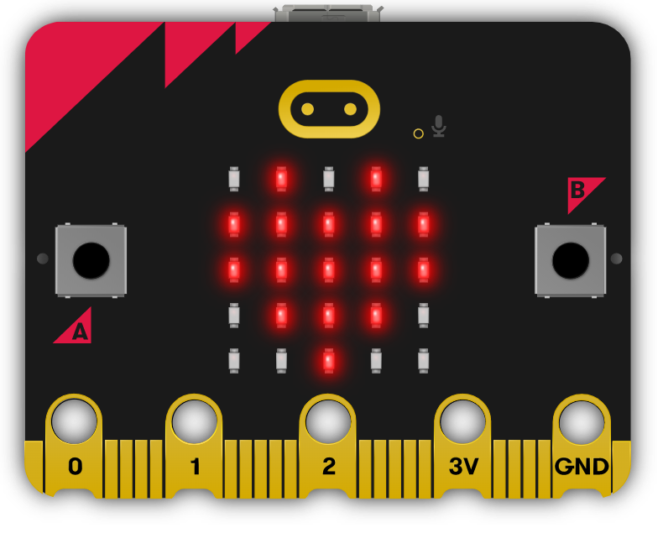
What Is a micro:bit?
When you receive your BBC micro:bit, everything you need to make a good start is included in the cardboard box. Your teacher might have already set up your micro:bit so you may not have seen what was inside the cardboard box.
The micro:bit is a pocket-sized computer.
It has an LED light display, buttons, microphone, sensors and many input/output features. These features can be programmed to let you physically interact with the world around you. There are so many possibilities with the BBC micro:bit.
The cardboard box contains:
micro:bit V2
USB data cable
safety guide
micro:bit cardboard case
battery pack and connector
2 x AAA batteries
a Get started manual

Slide 4
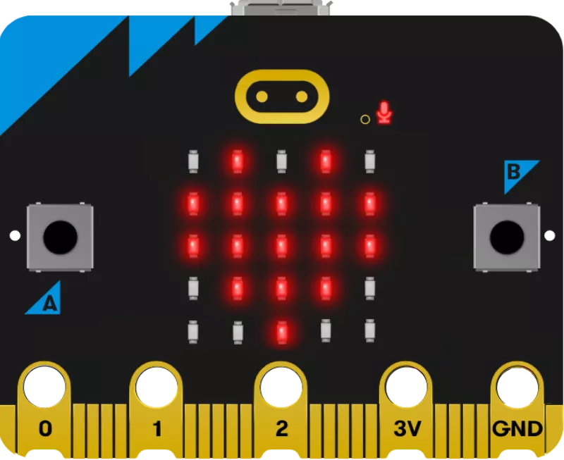
Parts of a BBC micro:bit
3V Pin
The 3 volt pin can be used to power accessories connected to the micro:bit.
LED Display and Light Sensor
The micro:bit has 25 LEDs arranged in a 5x5 grid. The LEDs can be used for displaying pictures, words and numbers. They can also act as sensors and measure light levels.
Microphone
The micro:bit has a
built-in microphone.
The microphone LED will light up if the microphone is measuring sound levels. The microphone LED also indicates where the microphone
is located.
Buttons
The BBC micro:bit has two buttons, A and B, on the front. The buttons can be pressed separately or together. Pressing the buttons can be used to trigger code.
GND Pin
The GND pin is the ground or Earth pin.
It can be used to complete a simple circuit when you connect headphones, LEDs or external switches to the micro:bit.
Touch Sensor
The gold logo also works as a touch sensor. It can be used as an extra button in your programs.
Pins
You will notice that the micro:bit contains small holes on the edge. These are called pins and these pins can be split into three categories: GPIO; 3V power; and GND.
The pins can be used to create circuits and physically connect the micro:bit to external things.
General Purpose Input and Output Pins
The GPIO pins are the three pins at the edge of the micro:bit labelled 0, 1 and 2. These pins can be used with crocodile clips or strips of foil to connect devices such as headphones, buzzers or switches made from cardboard and foil.
The 3V and GND pins are connected to the power supply of the micro:bit.
These pins should not be connected together.

Slide 5
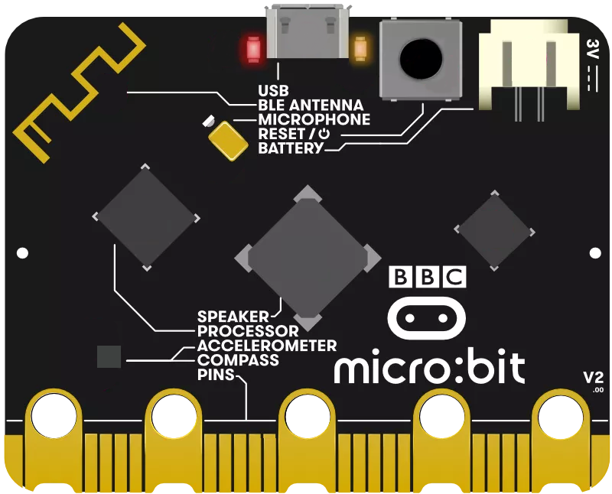
Parts of a BBC micro:bit
Micro USB Socket
A micro USB can be used to connect a computer or laptop to the micro:bit.
This allows the micro:bit to have programs transferred to it.
Radio and Bluetooth
The micro:bit can communicate wirelessly with other micro:bits using radio waves. Tablets can also connect to the micro:bit wirelessly via Bluetooth.
Processor
The micro:bit contains a microprocessor.
A processor is sometimes called the ‘brains’ of a computer.
The processor receives the inputs, runs the programs and gives outputs. It fetches, decodes and carries out the instructions coded on an online micro:bit editor.
Reset button
Use the reset button to reset the micro:bit or restart a program from the beginning.
You can also place the micro:bit into power-saving sleep mode by holding down the button and waiting until the red LED on the left goes dark before releasing the button.
Accelerometer
The micro:bit contains a motion sensor that measures movement. The accelerometer can detect when the micro:bit is tilted left to right, backwards and forwards and up and down.
Battery
The micro:bit can be powered using a battery pack. Instead of using a computer to power it, the battery pack can be plugged into the micro:bit. Using the battery pack is very handy if you want to take the micro:bit outside.
USB interface chip
The interface chip allows you to connect a computer to a micro:bit so you can transfer programs to it and power it.
Single LEDs
The right-hand single LED on the back of the micro:bit will flash yellow when a program is being flashed on to it. The left-hand single LED will light up red to show that the micro:bit is being powered by either the micro USB socket or a battery pack.
Compass
The micro:bit has a built-in compass that can detect the direction in which it is facing.
Temperature Sensor
The micro:bit has a temperature sensor inside the processor that can give you an approximation of the air temperature.
It will measure the temperature in degrees celsius.

Slide 6


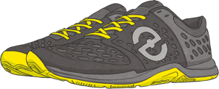

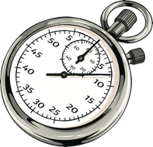
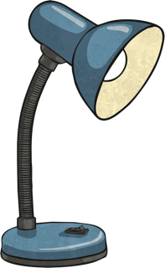
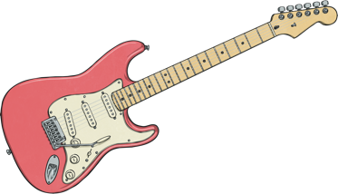
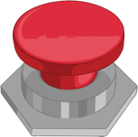

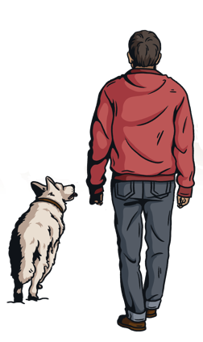
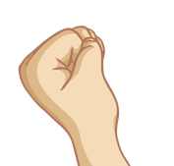
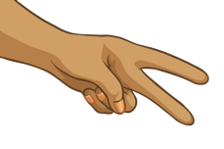
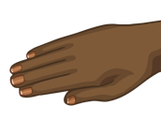
How Can a BBC micro:bit Be Used?
With the BBC micro:bit there are so many possibilities.
step counter
dice
thermometer
stopwatch
These are just some of the possibilities.
What will you make with a micro:bit?
nightlight
guitar
reaction games
name badge
clap-o-meter
animal tracker
rock, paper, scissors game

Slide 7
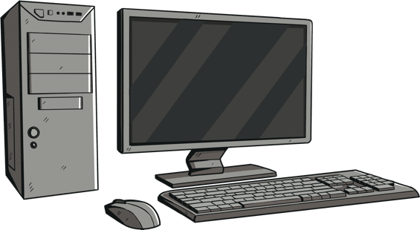
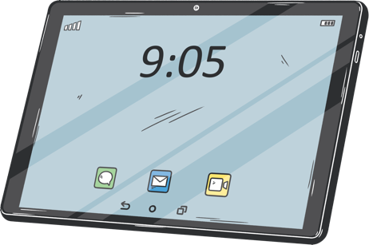

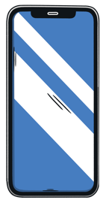
Let’s Get Started
How to Get Started
Now that you have learnt all the different parts of the micro:bit and some of the things you can do with it, let’s get started on creating something fantastic with a micro:bit.
As you might have realised, the micro:bit will not work on its own.
It needs someone to program instructions on to it. In computing, these instructions are called algorithms. Algorithms are used to create programs. These programs are written in code.
a desktop or laptop computer with a web browser and Internet access access
a phone or tablet with the free micro:bit app for MakeCode coding
To create a program you will need either:
How can I set it up?
or
Click here
if you are connecting
via a desktop or laptop computer.
Click here
if you are connecting
via a mobile device.

Slide 8
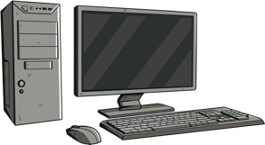

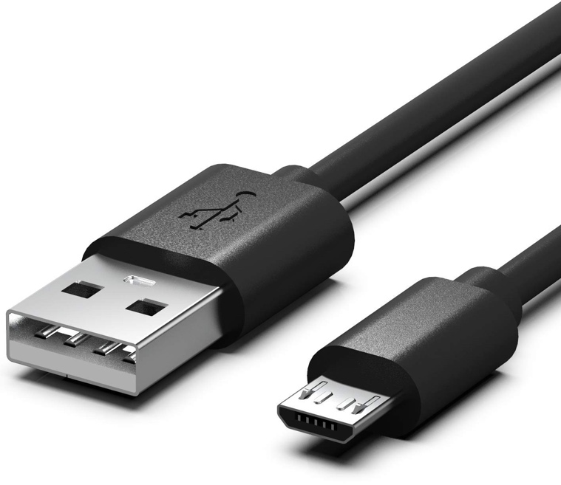
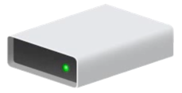
Connecting via Desktop or Laptop Computer
If you're using a desktop or laptop computer to connect to the micro:bit, you will need a micro USB data cable.
You should have received 30 of these in your BBC micro:bit start up boxes.
Plug the micro USB data cable into your micro:bit and then into your desktop or laptop computer. The BBC micro:bit will show up as a disk drive called MICROBIT.
MICROBIT

Slide 9
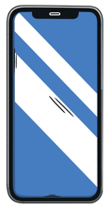
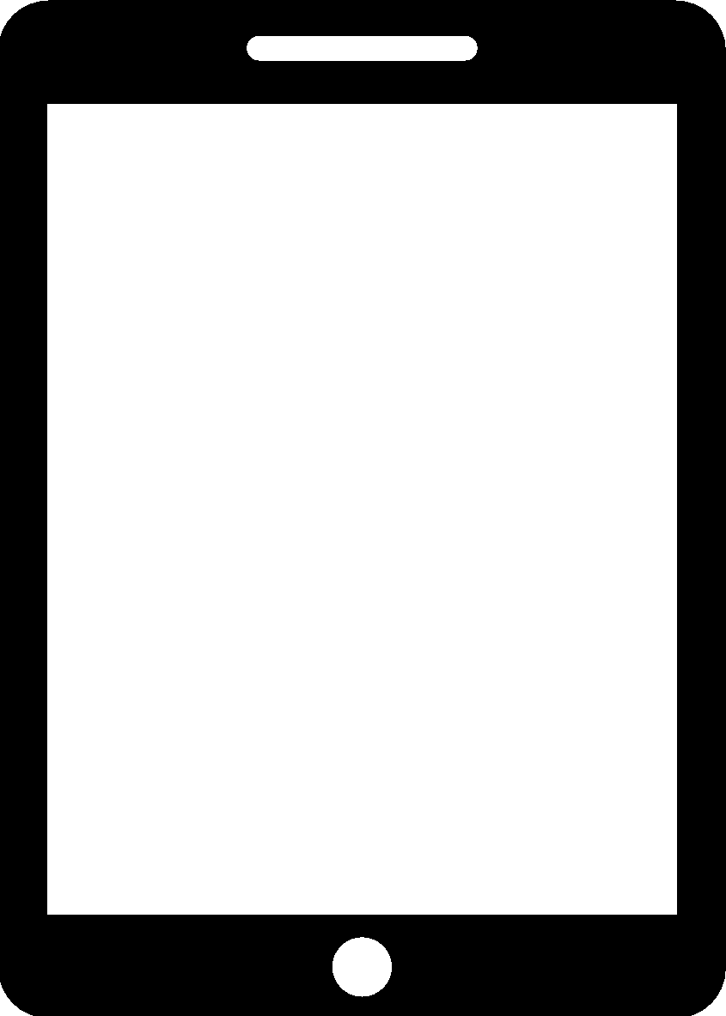

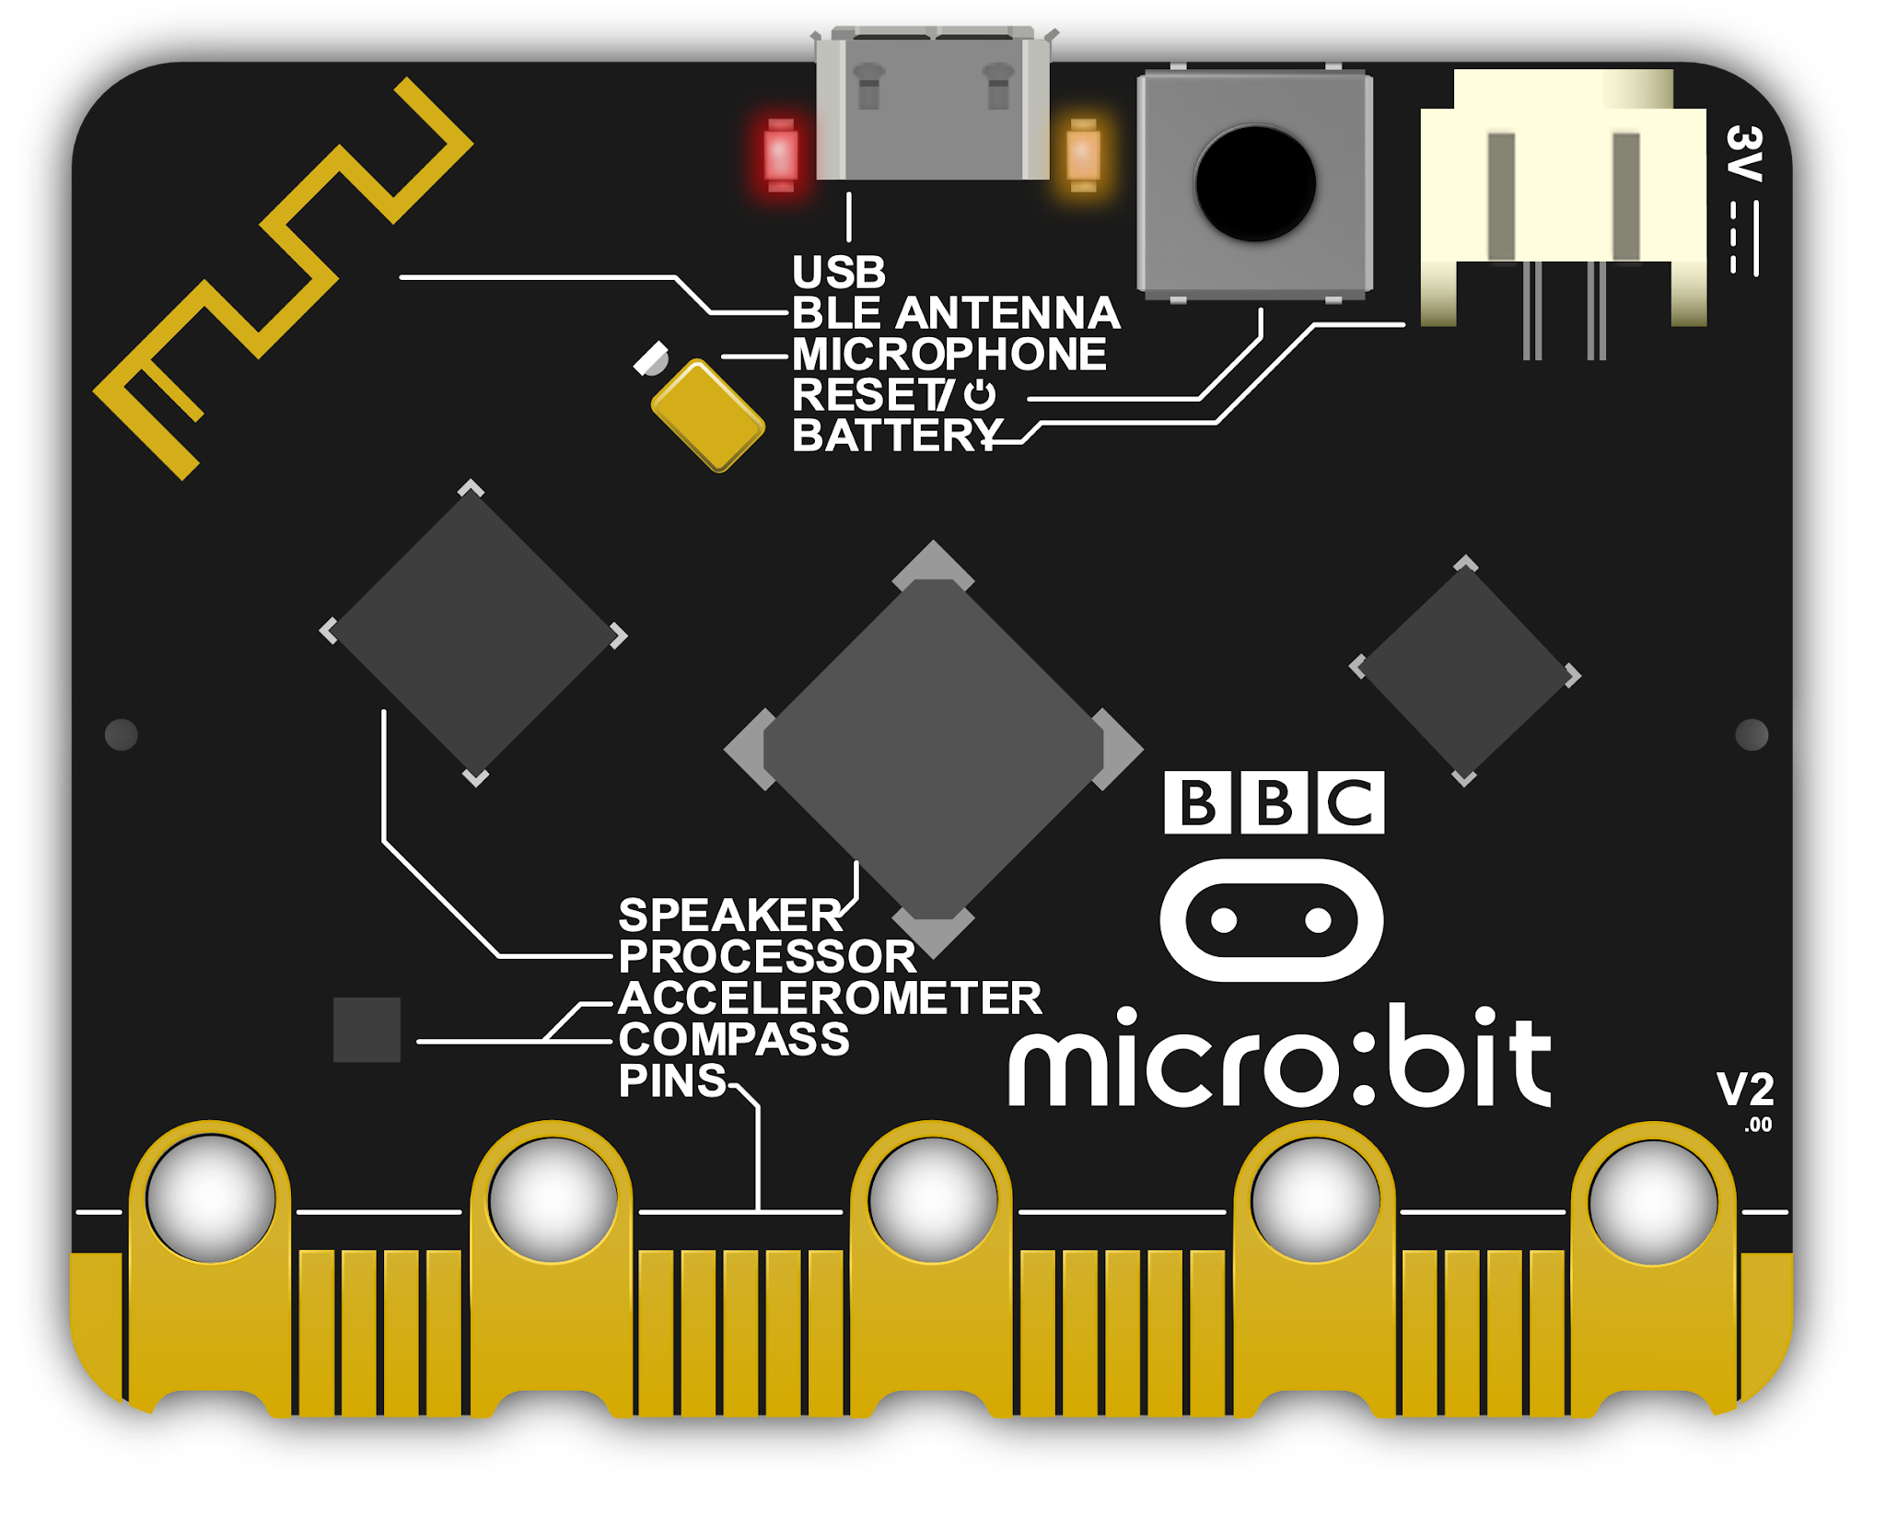

Connecting via a Mobile Device
If you're using a mobile device to connect to the micro:bit, you will need to connect them wirelessly through Bluetooth.

Slide 10
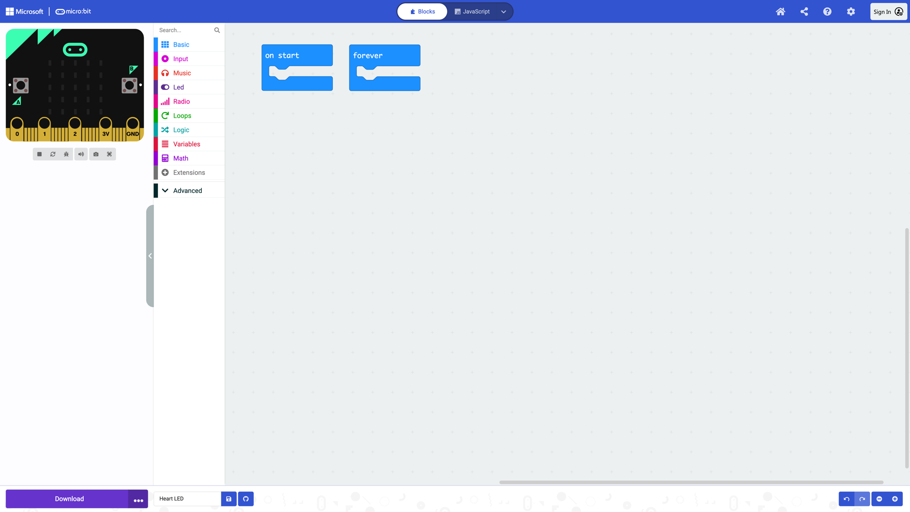
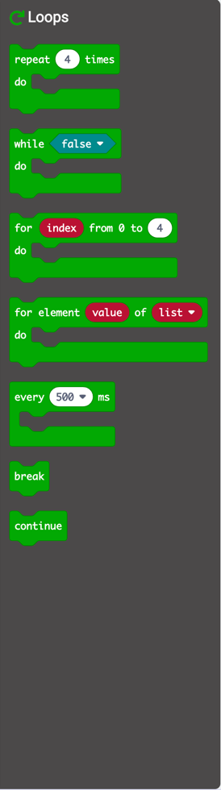
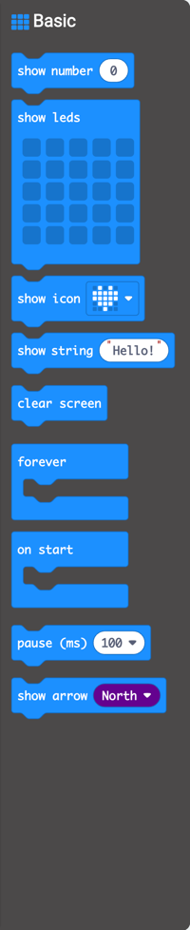
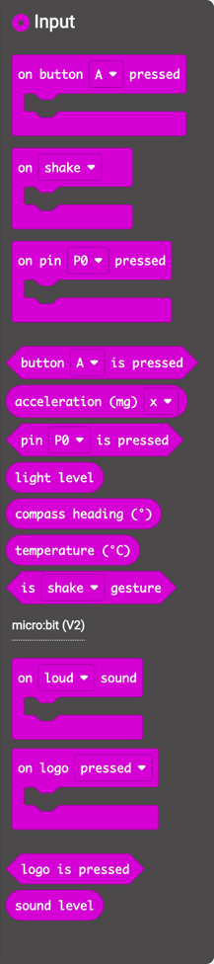

Let’s Get Coding
Now that your BBC micro:bit is connected, it’s time to start coding.
Microsoft MakeCode’s interface may look similar to other coding software you have used. In this lesson we will be using the coding blocks to create our programs.
There is a lot of different software that you can use to create programs for your micro:bit. We will be using Microsoft MakeCode.
A simulator of a micro:bit can be seen on the interface. This simulator will simulate what will happen on the micro:bit. It can be a great tool for debugging errors.
This section of the interface is called the blocks editor, select here to change it to the language editor.
The blocks editor offers a user blocks to slot together to create a program. The blocks can be found in the Blocks Toolbox. The Blocks Toolbox is split into different categories. The blocks colours correspond to the colour of the category names.
The blocks represent coding actions. Here you will find coding elements such as loops and conditional statements.
Blocks should be dragged from the Blocks Toolbox in to the editor workspace.

Slide 11
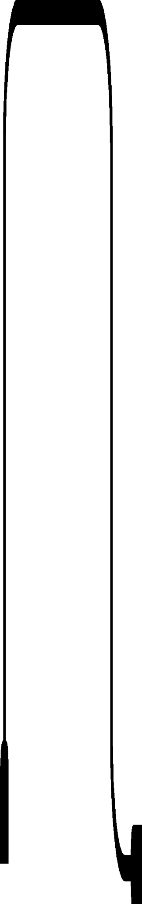
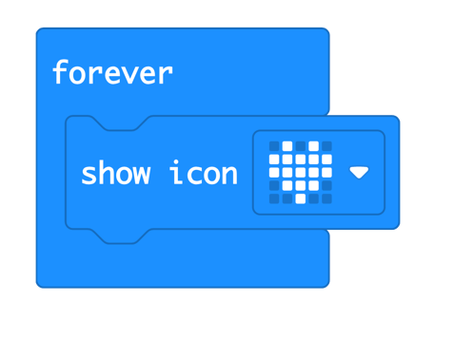
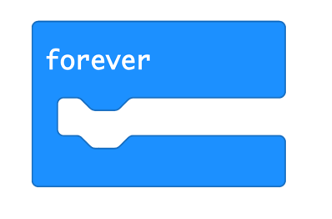
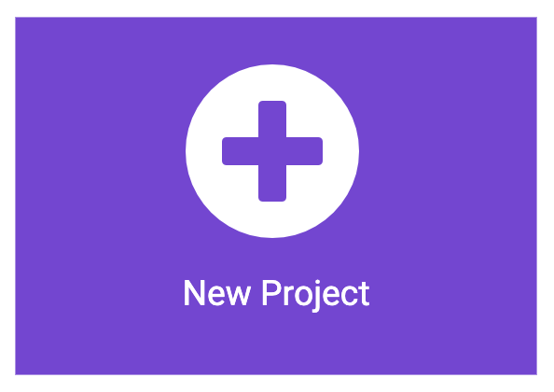
LED Image
Getting Started
Ensure your micro:bit is connected.
Open Microsoft MakeCode.
Start a New Project.
Code
Select a forever Basic block.
Slot in a show icon Basic block.
Choose an image from
the drop-down box.

Slide 12
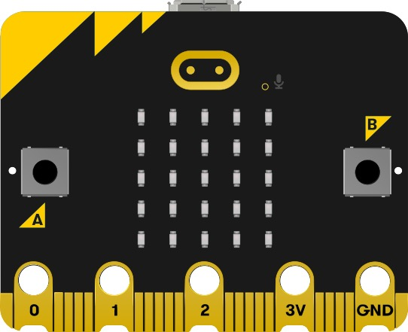


Beating Heart
Test
Test your code by selecting the play button to start the simulator.
The simulator can be a great tool for seeing the program run before flashing to allow opportunity for debugging.
Download
Now you need to flash your
program onto your micro:bit.
Click here if you are flashing via a desktop or laptop computer.
Click here if you are flashing via a mobile device.

Slide 13
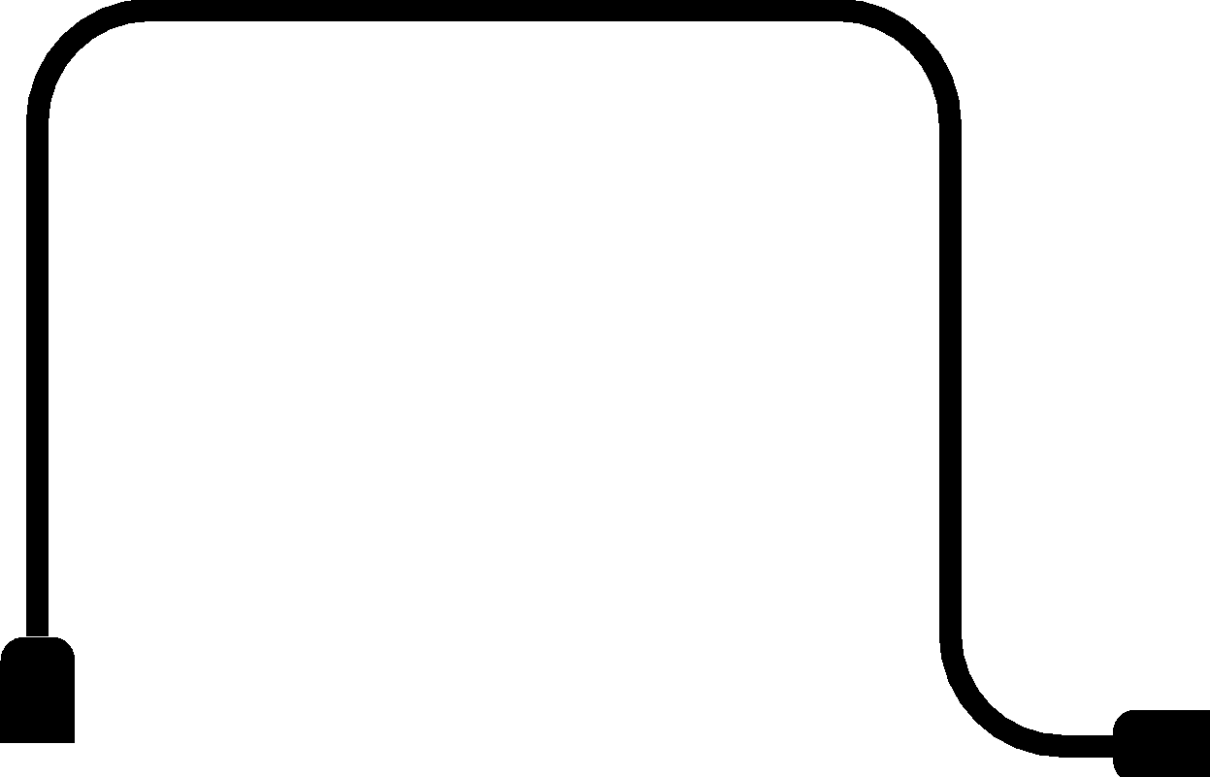




Transferring Files via Desktop or Laptop Computer
When the .hex file has been transferred to the MICROBIT drive, the MICROBIT drive will disconnect and reconnect as the micro:bit resets. The .hex file will not be visible on the MICROBIT drive but the program will be on the micro:bit.
Transferring a program to a micro:bit is called flashing.
This is because the program is copied to the micro:bit’s flash memory.
To flash a program on to the micro:bit, you should:
• download your program as a .hex file from the code editor to your desktop
or laptop computer;
• drag and drop the .hex file on to the MICROBIT drive.
When programs are being flashed on to the micro:bit, the micro:bit will pause and the yellow LED on the back will blink.
.hex
Microbit

Slide 14



Transferring Files via a Mobile Device
To flash a program on to the micro:bit, you should:
Transferring a program to a micro:bit is called flashing.
This is because the program is copied to the micro:bit’s flash memory.
• download the free micro:bit app to a mobile device;
• enable Bluetooth on your mobile device;
• follow the on-screen instructions.
Bluetooth
Hello
To Note:
The instructions will differ from mobile devices using different operating systems such as iOS and Android.
micro:bit

Slide 15
Wow!
Isn’t that amazing?
You should now see you chosen image appear
in LED lights on your micro:bit.

Slide 16
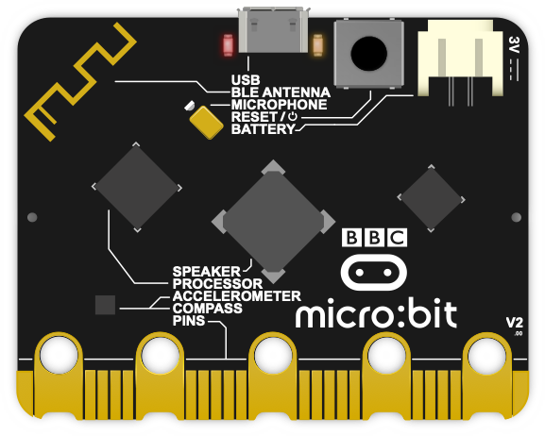
Error Codes
Oh no!
What happens if an error code has appeared?
As with all technology, micro:bits can experience problems, although these are minor.
Luckily, if the micro:bit detects a fault it will enter a ‘panic’ routine. In this ‘panic’ routine the micro:bit will display a sad face on the LED screen followed by a number. The number corresponds to a specific error.
In all error cases, pressing the reset button on the back of the micro:bit will restart the program. Restarting the program will clear out the RAM memory.
If restarting the micro:bit does not resolve the error,
there is more help and support on the micro:bit website.

Slide 17
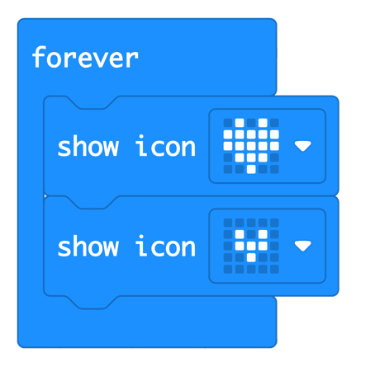
Beating Heart
Getting Started
Ensure your micro:bit is connected.
Open Microsoft MakeCode.
Start a New Project.
Code
Select a forever Basic block.
Slot in a show icon Basic block.
Ensure the heart is showing in
the drop-down menu.
Add another show icon Basic block.
Select the smaller heart from the drop-down menu.

Slide 18

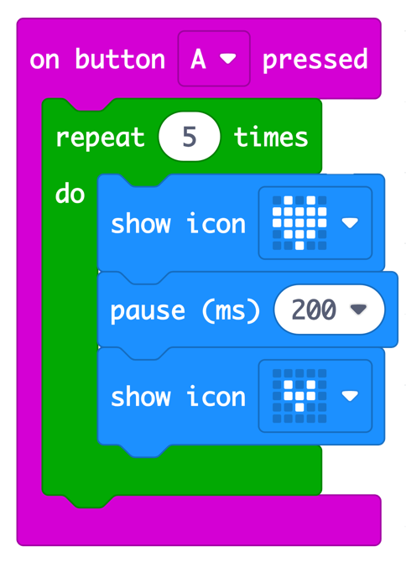
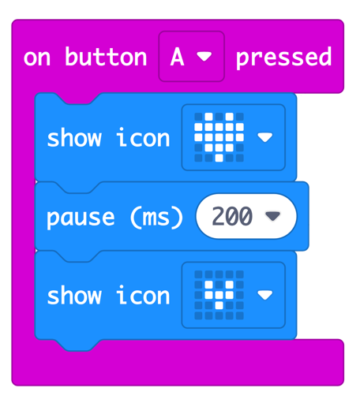
Beating Heart
Loop
Now instead of a forever Basic block, you should have a
on button A pressed Input block.
However, you may have noticed that the heart doesn’t beat anymore. We need to add a
loop in.
Now, add a repeat Loops block and type 5 into the white space. Your repeat loop should go around the code you wish to repeat.
Feeling Confident?
Can you alter the code so that the heart only beats when button A is pressed?
Did you notice any changes to your program?
How did you change your code?

Slide 19
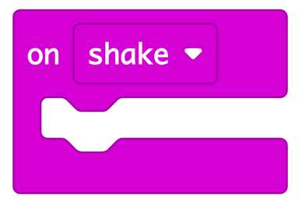
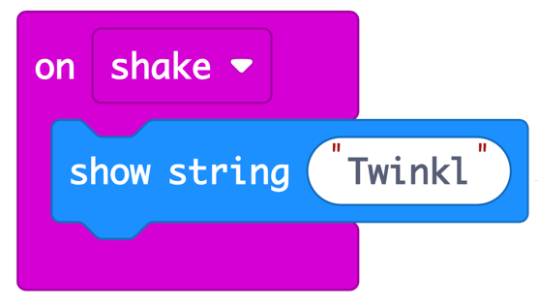
Shaking Name Badge
Getting Started
Ensure your micro:bit is connected.
Open Microsoft MakeCode.
Start a New Project.
Code
Select the on Input block and select
shake from the drop-down menu.
Insert a show string Basic block
and type your name in the white space.

Slide 20
Shaking Name Badge
Test
Test your code by selecting the play button to start the simulator.
Download
Now you need to flash your
program onto your micro:bit.
You should now see your name appear on your micro:bit when you shake it.
Challenge
Using what you have practised so far, write the code that will make your micro:bit show the temperature.

Slide 21
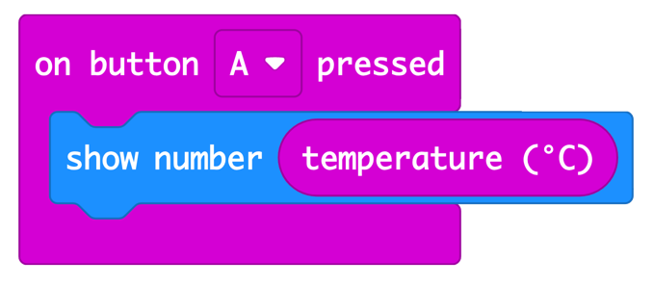
Thermometer
You code may look something similar to this!
Getting Started
Well done! You have just created a thermometer.

Slide 22
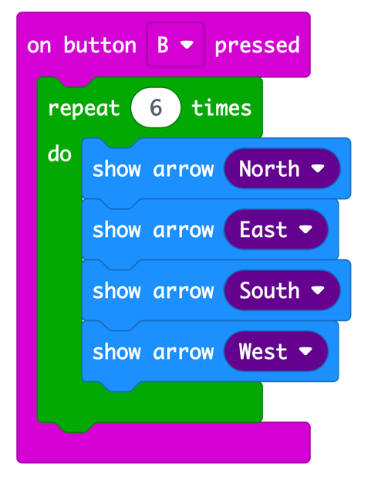
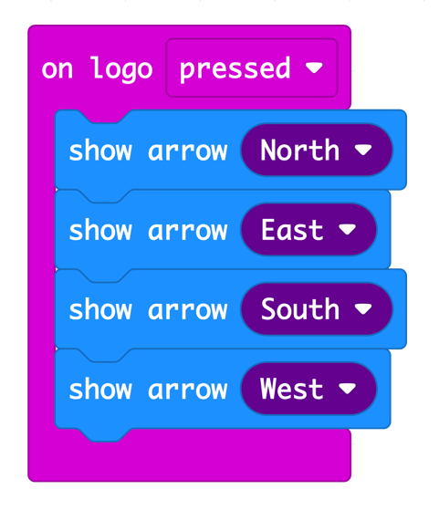

Debugging
That was some excellent coding.
Now spend some time experimenting with your BBC micro:bit.
What amazing things will you create?
A program has been created to show different arrows. The program should repeat 6 times when button B was pressed. It doesn’t seem to be working.
Can you debug and find out why?
That’s right!
The code should look like this.

Slide 23


Quiz Time
Create a new program where if button A is pressed a smiley face appears and if button B is pressed a sad face appears.
The smiley face will represent true, the sad face will represent false. After each statement, press the button that corresponds to either the smiley or sad face.
True or False?
The process of putting a program on to the micro:bit is called flashing.
The micro:bit has a built-in microphone.
The BBC micro:bit is for advanced coders only.
The micro:bit contains a temperature sensor.
The 3V and GND pins can be connected to each other.

Slide 24
